Slide 1
Data Mining approach of detecting Fake News- South Asian Context
Proposed By-
Farzana Islam
S.M.Shahadat Hossain
Mehedi Hasan
Minhazul Alam
Sabrina Yeasmin
Kawsin Jannat
Abdul Motaleb

Slide 2
FakeNewsTracker
A tool for fake news collection, detection,and visualization
Computational and Mathematical Organization Theory
Kai Shu · Deepak Mahudeswaran · Huan Liu
https://doi.org/10.1007/s10588-018-09280-3
Springer , Published Online : 13 October 2018

Slide 3
Abstract
People have changed their habit to get the news or information in last 10 years or simply we can say, they have changed the source of information. Newspaper, TV to Blogs, Online newspapers, Social Networking Sites(SNSs).
With the speed and technology , Fake news also propagates wide & too fast and puts negative impact on social life.
In this paper , they presented a system which automatically collects data for news pieces and social context and helps to predict fake news with visualization techniques.

Slide 4
Introduction
Target for fake news: Social Media Platforms
Reason: People spend more time in those platforms as its Free , Easy to Access and easiest way to express inner feelings.
Negative Side: People are prone to Fake(False, Disinformation) news. Some people / agency dedicatically adopt the way for political / financial gain
Current Preventive Measures: Some Fact Checking websites available but as those require expert analysis, it is slow method.
Side problem: Authentic Sources, which creates confusing which one(post/news) is actually true
Known Limitation: Due to the volume and diversity of the social media, it is almost impossible to manually label the fake news and true news.
Proposal: A framework which can help to detect fake news in early stage and avoid spreading.

Slide 5
Proposed Framework(FakeNewsTracker)
The major functionalities of FakeNewsTracker are as follows,
Fake news collection collecting news contents and social context automatically, which provides valuable datasets for the study of fake news.
Fake news detection extracting useful features and build various machine learning models to detect fake news;
Fake news visualization presenting the characteristics of fake news dissemination through efective visualization techniques.

Slide 6
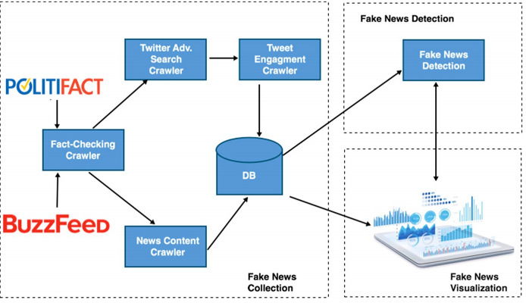
FakeNewsTracker- FlowChart

Slide 7
Dataset
Dataset for Fake News:
PolitiFact ( Fact Checking Website )
BuzzFeed ( Fact Checking Website )

Slide 8
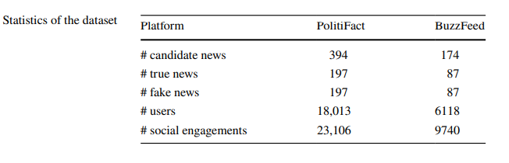
Dataset Stats

Slide 9
Dataset (cont'd)
Methodology for Data Collection:
Step1: Collected Verified News in interval to update the data repository
Step2: Collected related Tweets using Twitter Advance Search API
Step3: Traced Users who liked the tweets and Traced the comments and retweets (verifying true/fake) to understand if user identifed the news correctly or not.
Step4: Collected Followees and Followers of the user

Slide 10
Methodology
Detecting Fake News:
They proposed SAF (Social Article Fusion) model- uses Linguistic features of news content and features of social context for classification
News representation Learning:
Linguistic Feature used: News Content
Mechanism: Autoencoders (A neural network used for represent text content in lower dimensional space)

Slide 11
Methodology (cont'd)
An autoencoder generally consists of two parts an encoder which transforms the input to a hidden code and a decoder which reconstructs the input from hidden code.
Here auto encoder used to capture the text content of the news articles in the lower dimensional space z. Given a new article text document X = {x1, x2, …, xm} where xi is the i-th word in the document and find the representation z ∈ R^{k×1}
The encoder E ∶ X → Z learns a mapping function to map input document to lower dimensional space z. The decoder D = Z→ X learns the mapping to reconstruct the original document from the representation Z.
The encoder network takes an input word at each time stamp and produces an output and the hidden state of the last timestamp represents the content representation z.

Slide 12

Methodology (cont'd)
The decoder takes the output from time stamp t − 1 and previous timestamp’s hidden state for predicting the word at time stamp t. The output of decoder
s_{t} = f_{dec}(s_{t−1}, x̂_{t}) where s_{t−1} is the hidden state of the decoder at time t and s₀ = z and x̂_{t} is the output symbol from the timestamp t − 1 which becomes to the decoder at time t.
The autoencoder tries to minimize the reconstruction error from representation z to original document x. The reconstruction error is given by L_{AE} = L(x, D(E(x))
They use cross entropy as the loss function. The cross-entropy error for the reconstruction of the document is given as


Slide 13
Methodology (cont'd)
Social engagement learning:
Goal: Capturing the temporal(relative to time) engagements of the users with the fake news
Mechanism: RNN (Recurrent Neural Networks). The output of the RNN is considered as the social context feature for the classifcation. Long Short-Term Memory (LSTM) has been used in their experiments.
Social engagements like tweets and their replies are embedded in a certain format by the embedding layer before giving it to the network.

Slide 14
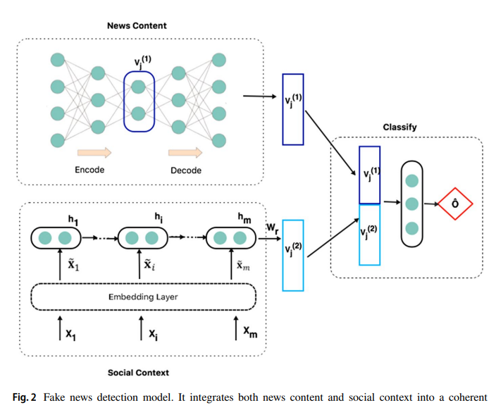
Detection Model

Slide 15
Methodology (contd.)
Social Article Fusion(SAF):
It combines the Autoencoder and RNN features to form a single concatenated feature vector V_{j} for the classifcation.
The softmax layer is used to classify the news articles in the output layer. The output of the SAF network is given by
y_{o} = softmax(WV_{j})
They run learning & classification task together. So features are learned relative to detection. They used cross entropy as loss function for output prediction.

Slide 16
Data Visualization
They have used 3 techniques to visualise the data
Word Cloud -> frequently used words in fake & real news
Geo-Visualisation -> geo-located fake tweets, identifying spreaded area
Network -> Twitter Users Network who shared fake and real news.

Slide 17
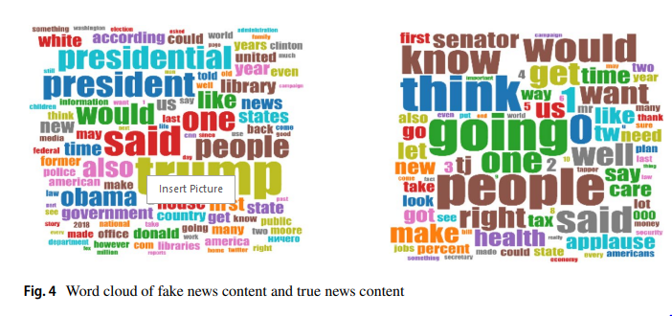
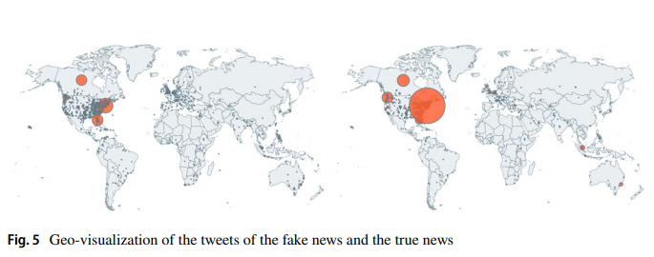
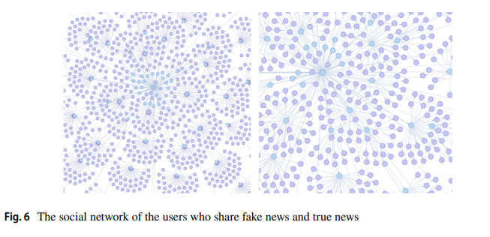
Data Visualization(contd.)

Slide 18
Experiment Result and Analysis
They experimented with the SAF model and dataset to get the answer of these two questions:
Can social media data be used for the fake news detection tasks?
Can they learn representation of the text content and social engagements that could be efectively used for the fake news detection tasks?

Slide 19
Experiment Result and Analysis(Contd.)
They used 3 variants of the SAF framework
SAF/S which uses only news article content.
SAF/A which utilizes only social context.
SAF which exploits both news article contents and social engagements.

Slide 20
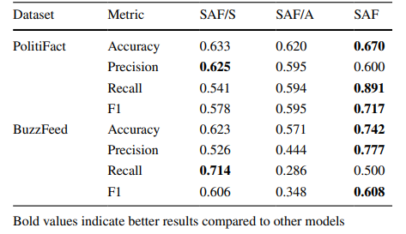
Experiment Result and Analysis(Contd.)
Fake News Detection Performance
(Better Performance when both News Article and Social Context are used) So Social Media Data can be used.

Slide 21
Experiment Result and Analysis(Contd.)
To test the quality of the learned features they try the classification task using the learned feature with standard machine learning algorithms like Support Vector Machine (SVM), Logistic Regression and Naïve Bayes.

Slide 22
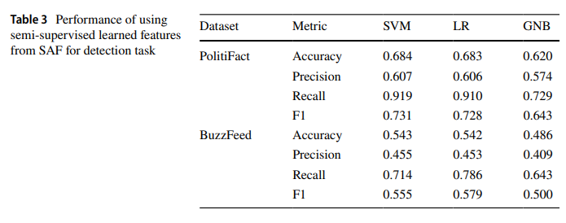
Experiment Result and Analysis(Contd.)
For the 3rd variant of SAF framework, they achieved good performance on using semi-suervised learned features which answers the 2nd question-> YES

Slide 23
Drawbacks
Database/Dataset not public
Data Pattern / Collecting algorithm from social media not disclosed.
No codes are public.
Not enough information to know about the whole process.

Slide 24
Project Proposal

Slide 25
Introduction
Fake news (also known as junk news, pseudo-news, or hoax news) is a type of yellow journalism or
propaganda that consists of deliberate disinformation or hoaxes spread via traditional news media (print and broadcast) or online social media.

Slide 26
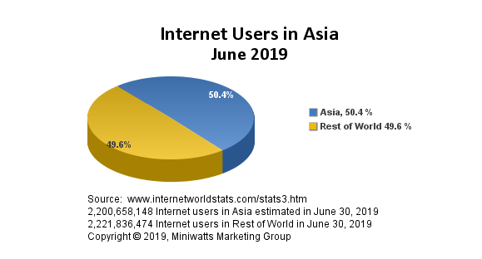
Survey Report

Slide 27
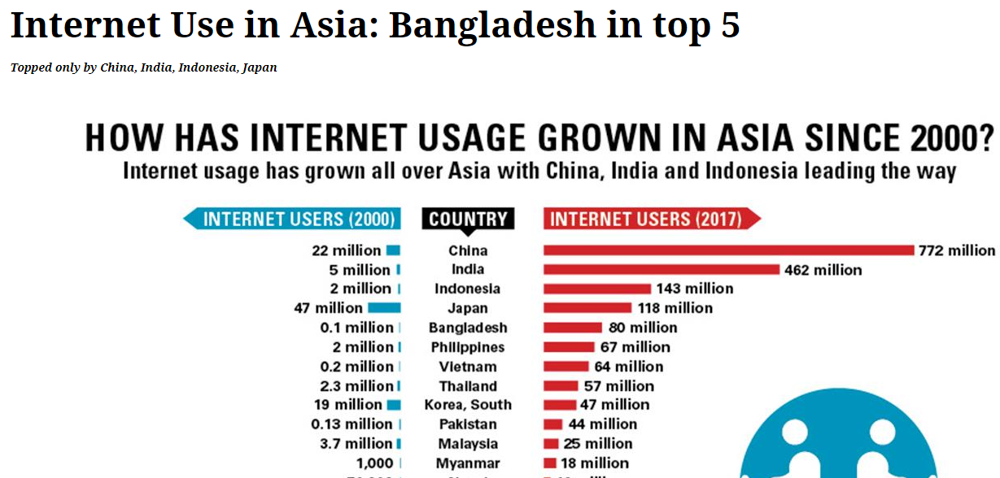
Survey Contd.

Slide 28
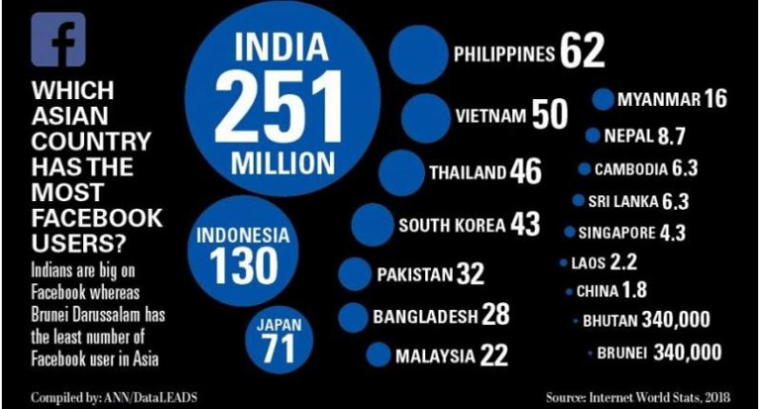
Which Asian Country Has the Most Facebook Users?
.

Slide 29
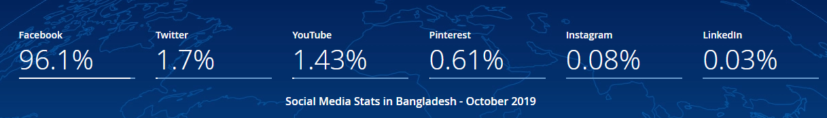
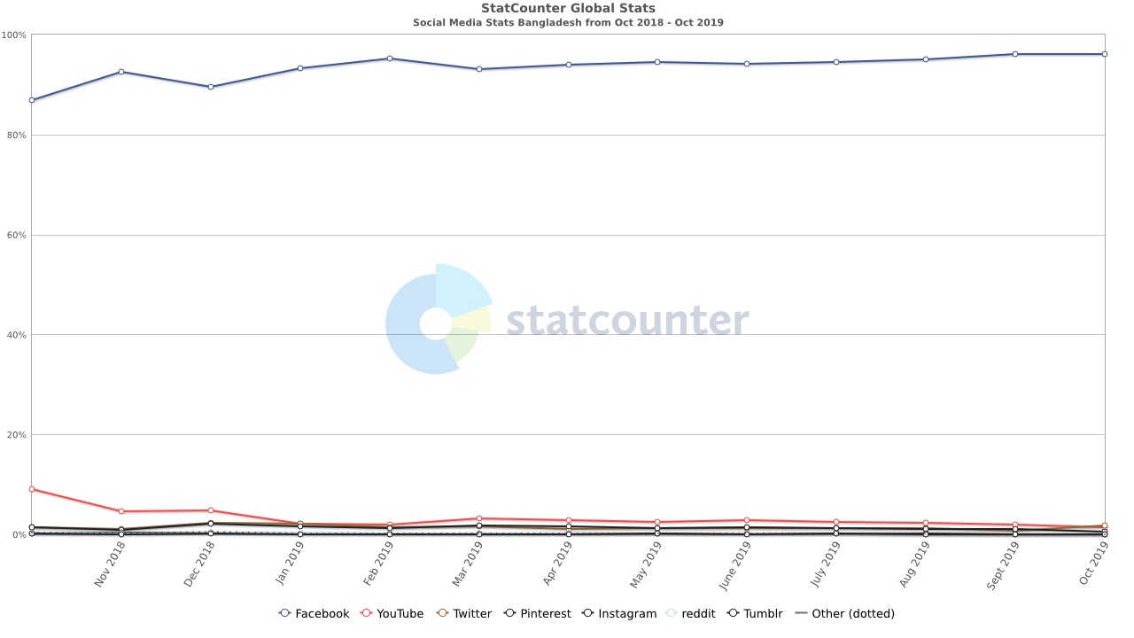
Bangladesh Social media user

Slide 30
Facebook users in Bangladesh
January 2019
There were 33 713 000 Facebook users in Bangladesh in January 2019, which accounted for 19.9% of its entire population.
The majority of them were men - 73.8%.
People aged 18 to 24 were the largest user group (15 600 000).
The highest difference between men and women occurs within people aged 18 to 24, where men lead by 6 400 000.

Slide 31
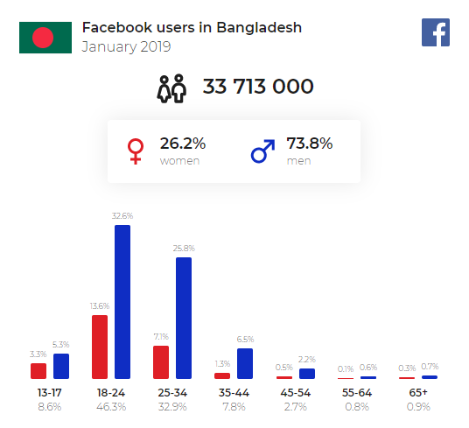
Contd.

Slide 32
Why Facebook?
A majority admit to falling for fake news at least once — citing Facebook as the leading source — and want both governments and social media companies to take action.
86% said they had fallen for fake news at least once, with 44% saying they sometimes or frequently did. Only 14% said they had “never” been duped by fake news.
Facebook was the most commonly cited source of fake news, with 77% of Facebook users saying they had personally seen fake news there, followed by 62% of Twitter users and 74% of social media users in general.

Slide 33
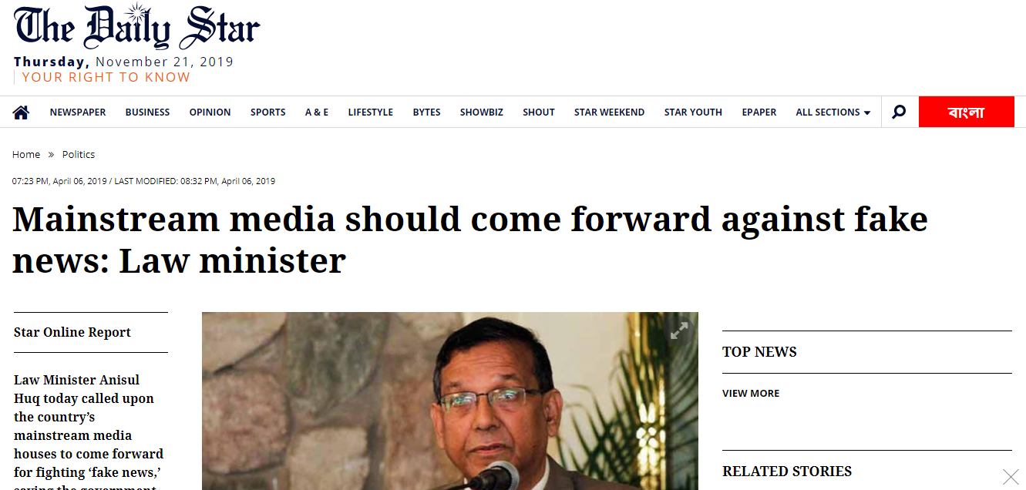
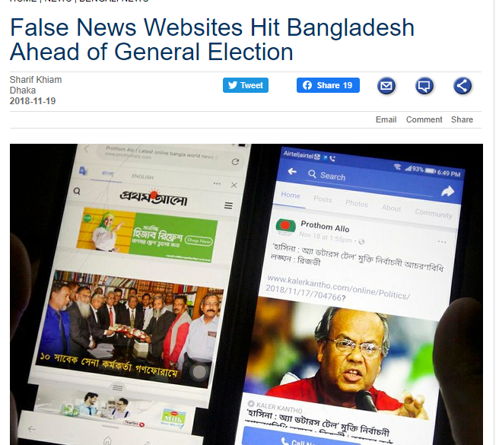
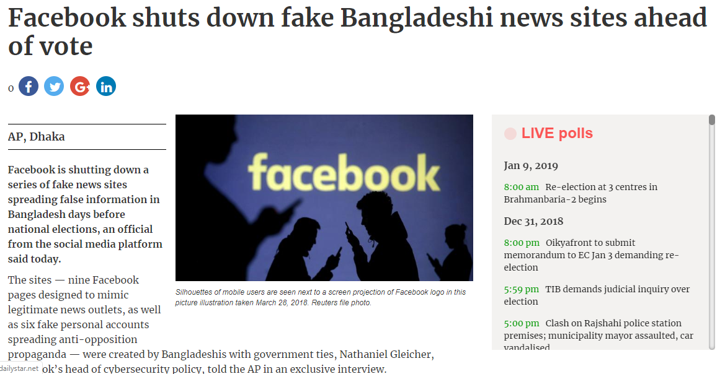
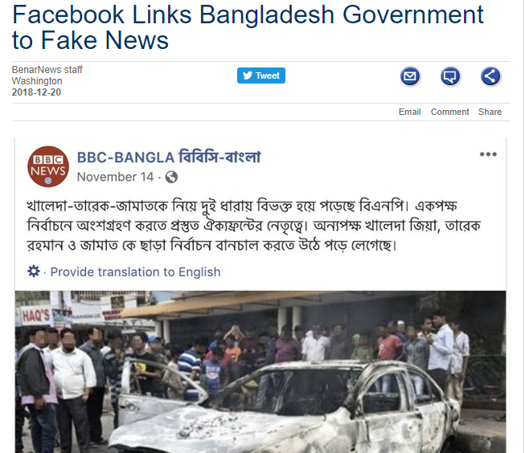
Importance of Fake News Detection in Bangladesh!

Slide 34
Dataset
Input
  A headline and a body text - either from the same news article or from two different articles.
Output
  Classify the stance of the body text relative to the claim made in the headline into one of four categories:
    Agrees: The body text agrees with the headline.
    Disagrees: The body text disagrees with the headline.
    Discusses: The body text discuss the same topic as the headline, but does not take a position
    Unrelated: The body text discusses a different topic than the headline

Slide 35
Dataset Contd.
EXAMPLE HEADLINE
“৯ বছর বয়সেই বিশ্ববিদ্যালয়ের ডিগ্রি”
“……মাত্র ৯ বছর বয়সেই বেলজিয়ান এক বালক বিশ্ববিদ্যালয় থেকে ডিগ্রি নিতে চলেছে……”
CORRECT CLASSIFICATION: AGREE
“……বেলজিয়ান এক বালক বিশ্ববিদ্যালয় থেকে ডিগ্রি নিতে চলেছে……”
CORRECT CLASSIFICATION: Discusses
“……বেলজিয়ান এক বালক কৃত্রিম অঙ্গ প্রত্যঙ্গ তৈরি করতে চায় ……”
CORRECT CLASSIFICATION: UNRELATED
“…স্কুল লরেনের কাছে খুব একটা আনন্দের জায়গা না। সে বলছে, "স্কুল হচ্ছে একঘেয়ে জায়গা..”
CORRECT CLASSIFICATION: DISAGREE

Slide 36
Proposed Methodology
For Dataset
Database (.JSON)
Scrapper (Python URL)
Parsing Mechanism
Facebook Graph database

Slide 37
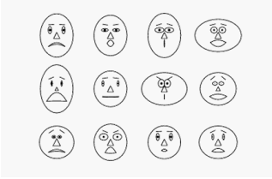
Proposed Methodology contd.
For Classification
Data Mining Algorithm including- naïve Bayes, Decision tree, logistic regression, K nearest neighbor (KNN)
For data Visualization
Chernoff face algorithm

Slide 38
References
http://www.fakenewschallenge.org/
https://www.cigionline.org/internet-survey-2019?gclid=Cj0KCQiAiNnuBRD3ARIsAM8KmluFBv-jJ4RkcfqZV3Z4lA0J5xeTTQCbxqZ2SNLgNNwwznoRAYTDHUgaAk_6EALw_wcB
https://en.wikipedia.org/wiki/Fake_news
https://www.nationthailand.com/Startup_and_IT/30355459
https://www.thedailystar.net/online/top-internet-using-country-2017-in-asia-bangladesh-5th-1643752
https://napoleoncat.com/stats/facebook-users-in-bangladesh/2019/01
https://gs.statcounter.com/social-media-stats/all/bangladesh
https://www.internetworldstats.com/stats3.htm
https://www.benarnews.org/english/news/bengali/bangladesh-censorship-11192018173823.html
https://www.thedailystar.net/politics/mainstream-media-should-come-forward-against-fake-news-in-bangladesh-1725808
https://www.thedailystar.net/bangladesh-national-election-2018/facebook-shuts-down-fake-bangladeshi-news-sites-ahead-bangladesh-election-vote-1676464
https://www.benarnews.org/english/news/bengali/fake-accounts-12202018164505.html
https://www.bbc.com/bengali/news-50489485

Slide 39
Thank You
-Any Question?

